Slide 1
Redundant medicine donation Portal
PRESENTED BY
Tuhin Hossain Id: 171-35-1947
Department of Software Engineering
Daffodil International University
SUPERVISED BY
Mr. khalid been badruzzaman
lecturer
Department of Software Engineering
Daffodil International University

Slide 2
Background of project
Redundant medicine donation project are to prepare a portal for the collection of
medicine which is unused by the patient who recovers completely.
This drug donation system helps the user to donate unused medicines to Health
organization /NGO.
Organization /NGO can help needy poor people by that donated medicine. In this
medicine donation System

Slide 3
ABSTRACT
Redundant medicine donation portal system is a web-based application .The aim and objective of this medicine donation project are to prepare a portal for the collection of unused medicine for further utilization by a needy person. This website donor can registration for being a Donor , then after login he can donate medicine. Health Organizer can collecting the medicine whice donor donate them. Organizer and Donor both can give feedback about this system .Admin can manage all member and see all feedback and transaction of donating. This project will help them a lot.

Slide 4
Functional requirement
Registration
Login
Management
Transaction
Donation
Donating History
Assign Executive
Medicine collecting status
Block member
Check assign
Feedback
Update

Slide 5
Non-functional requirement
Usability
Recoverability
Security
Availability
Reliability
Design & colour

Slide 6
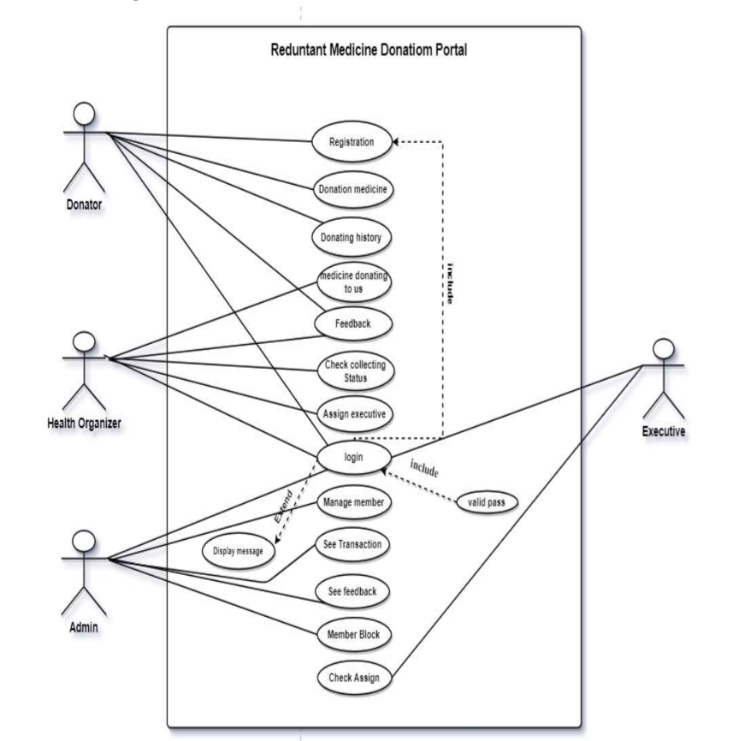
Use Case Diagram

Slide 7
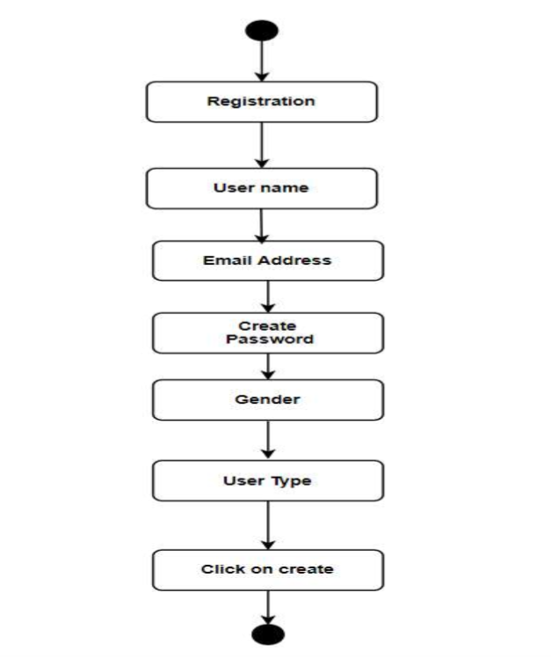
Activity Diagram Registration

Slide 8
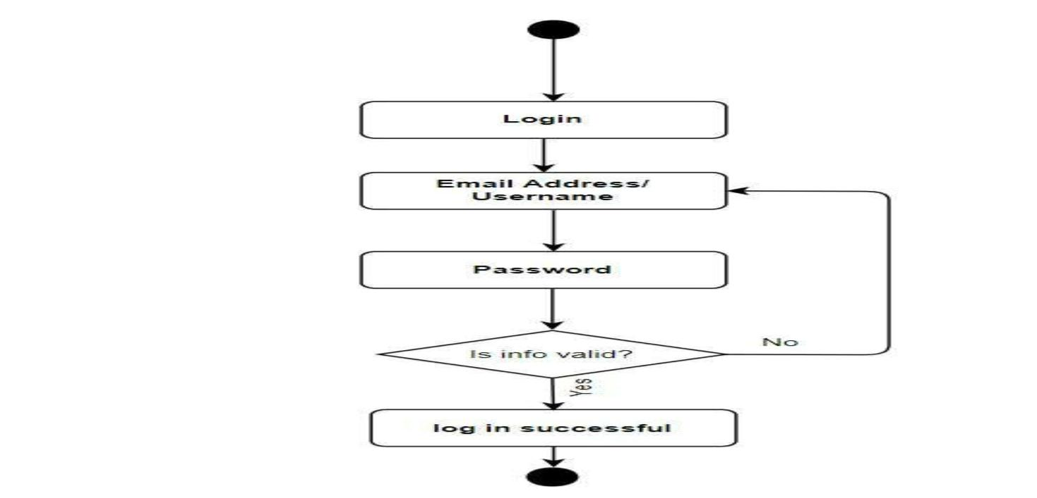
Login

Slide 9
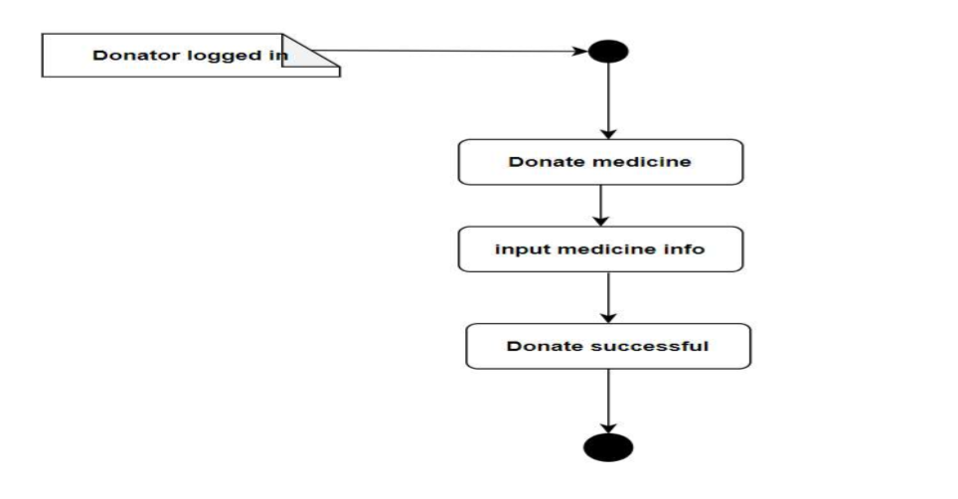
Activity diagram for medicine donation

Slide 10
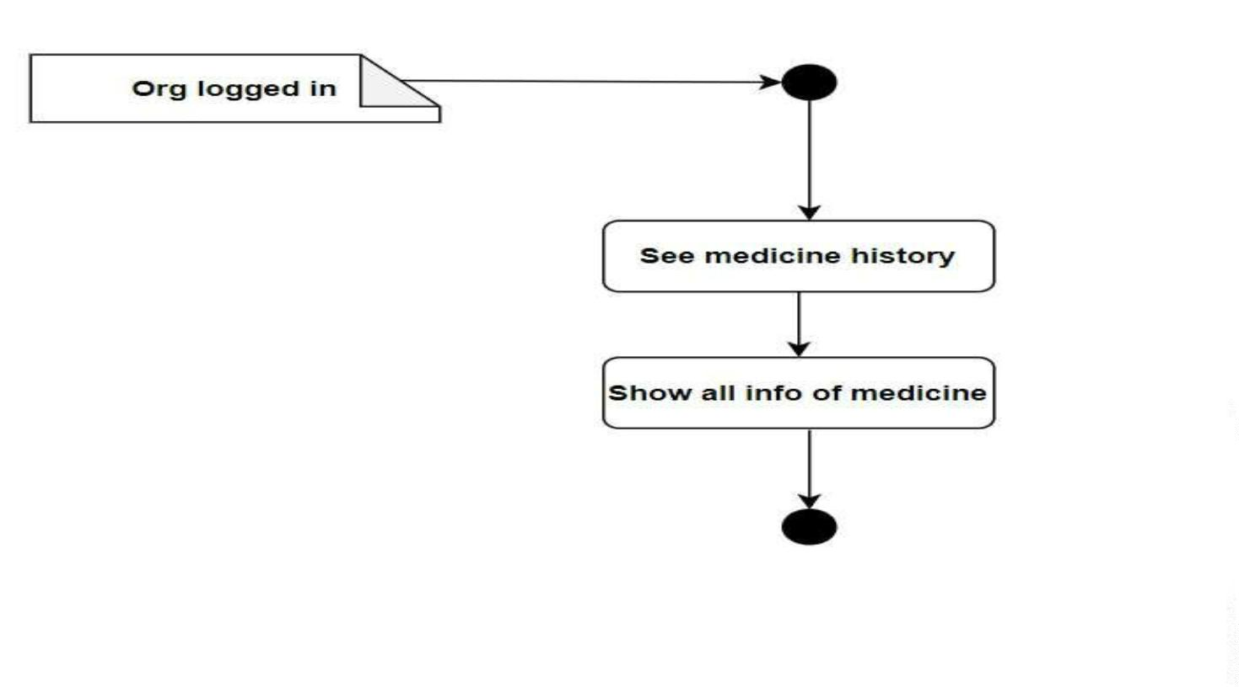
Donating Medicine History of our Organization

Slide 11
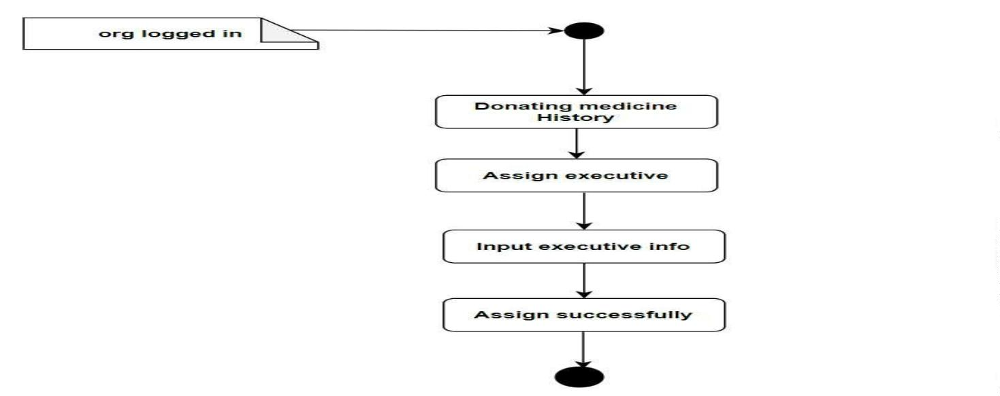
Assign executive

Slide 12
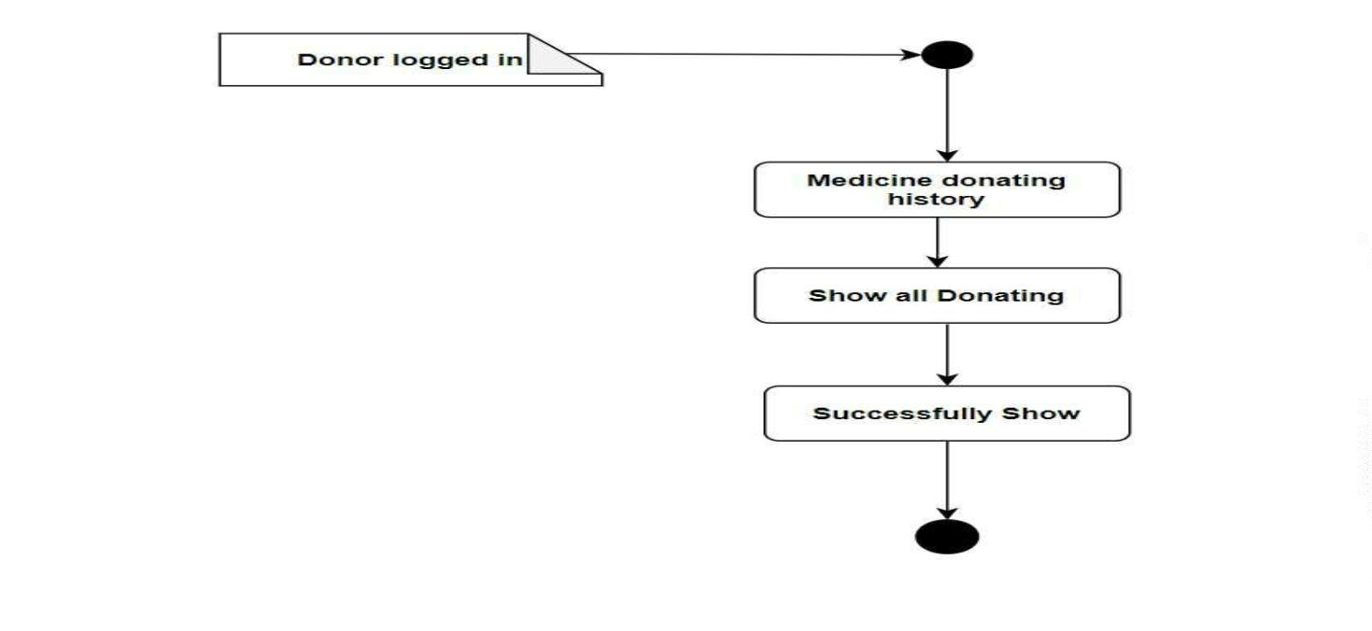
Donation history

Slide 13
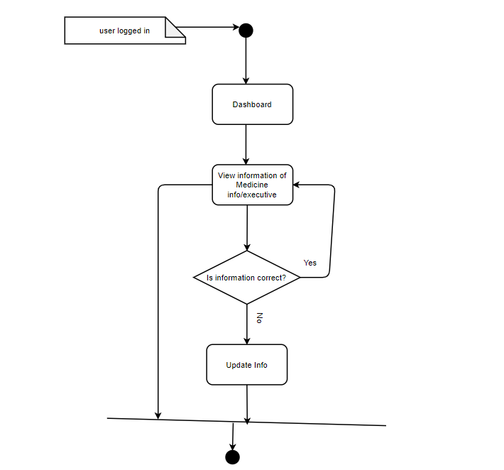
Update Information

Slide 14
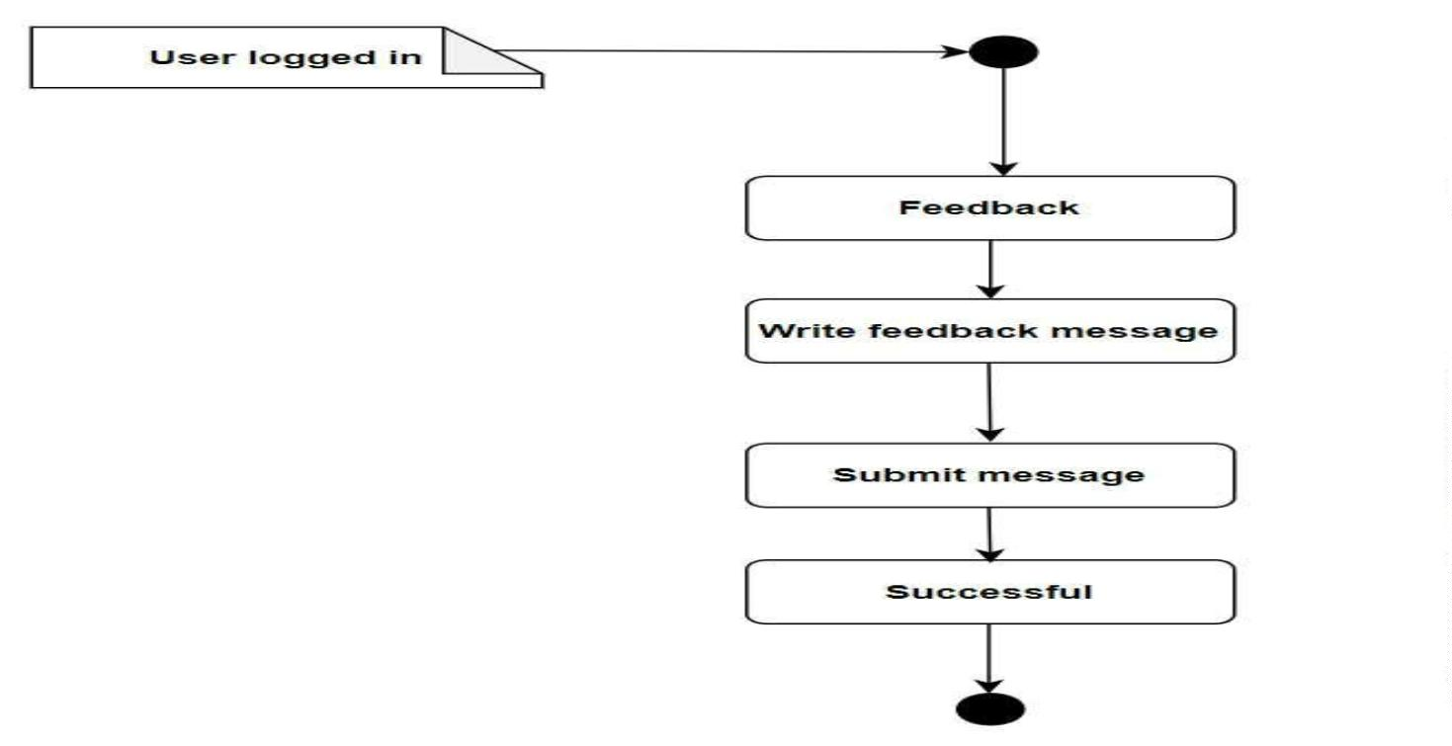
Feedback

Slide 15
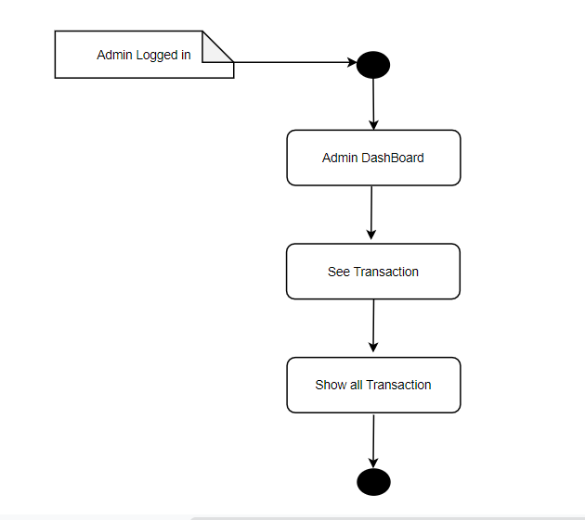
Transaction

Slide 16
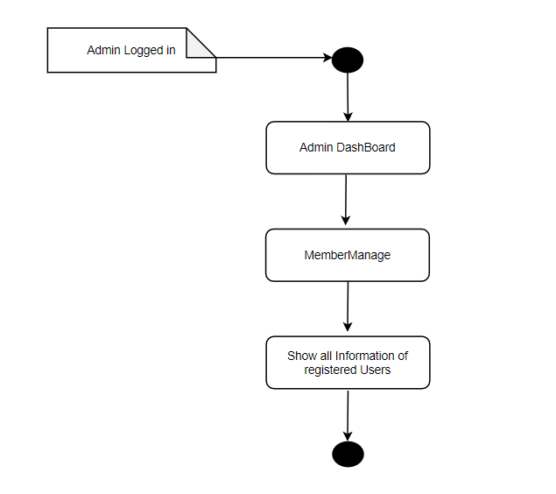
Managements

Slide 17
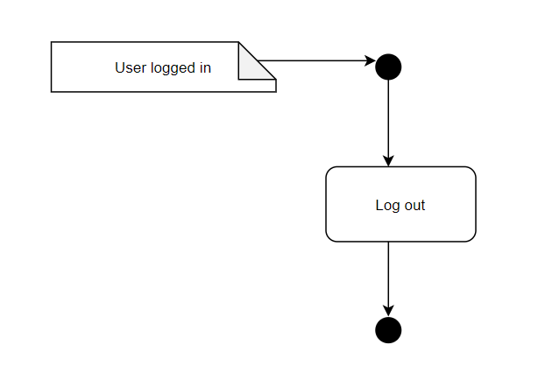
Log out

Slide 18
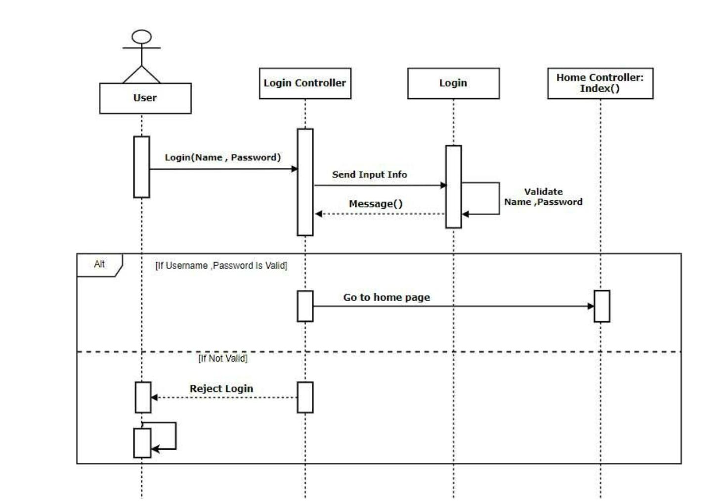
login

Slide 19
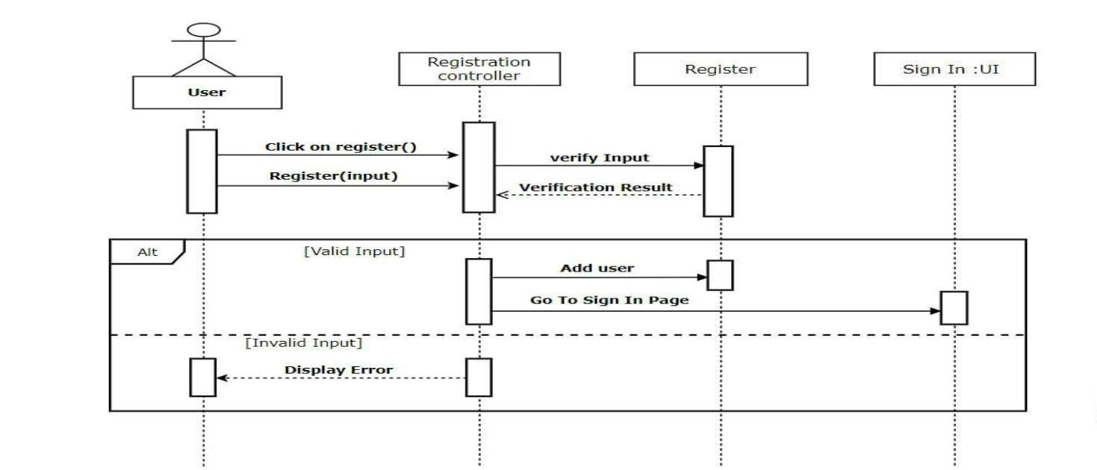
Registration

Slide 20
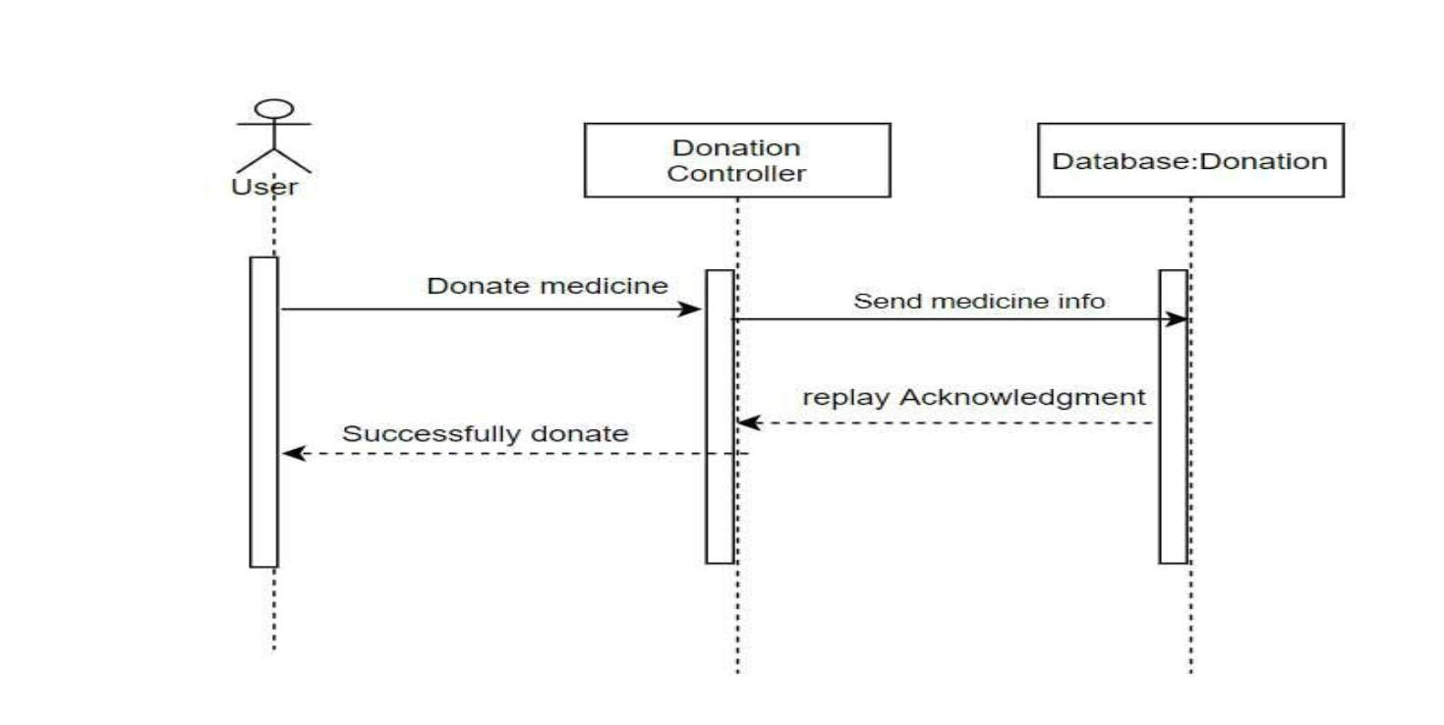
Donate medicine

Slide 21
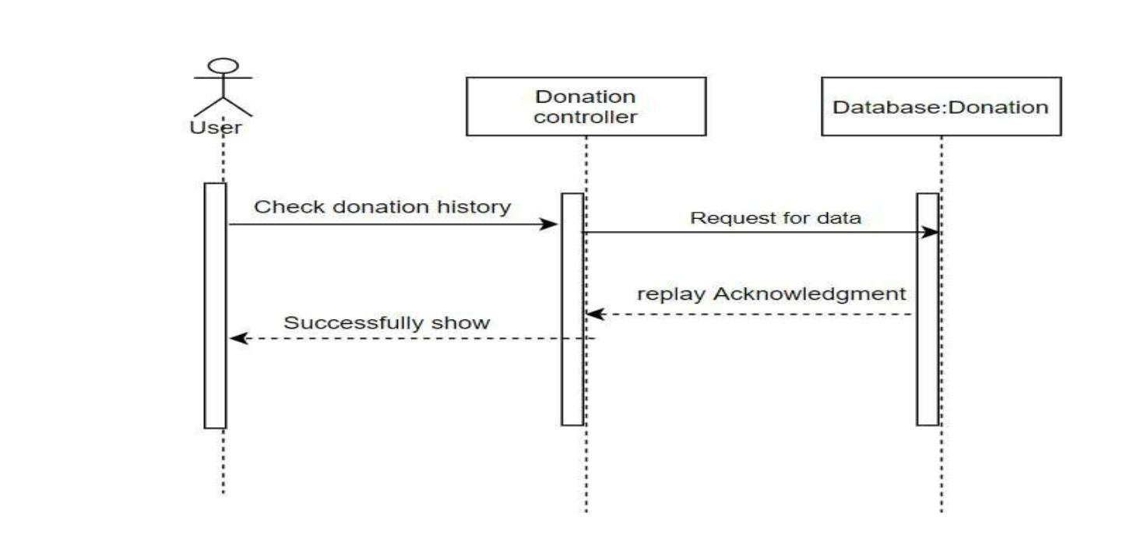
Donation history check

Slide 22
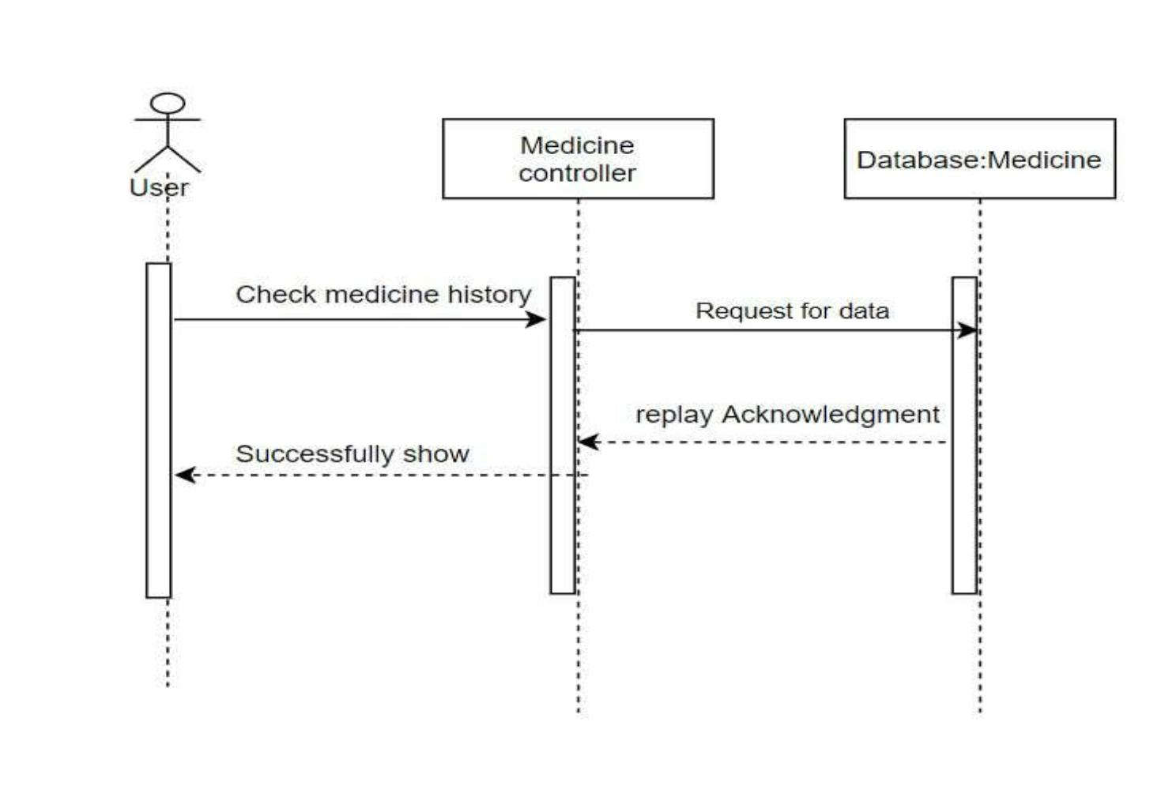
Medicine Donation to Organization

Slide 23
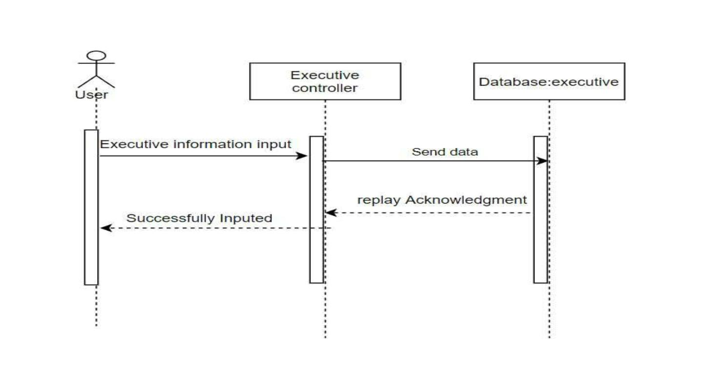
Assign executive

Slide 24
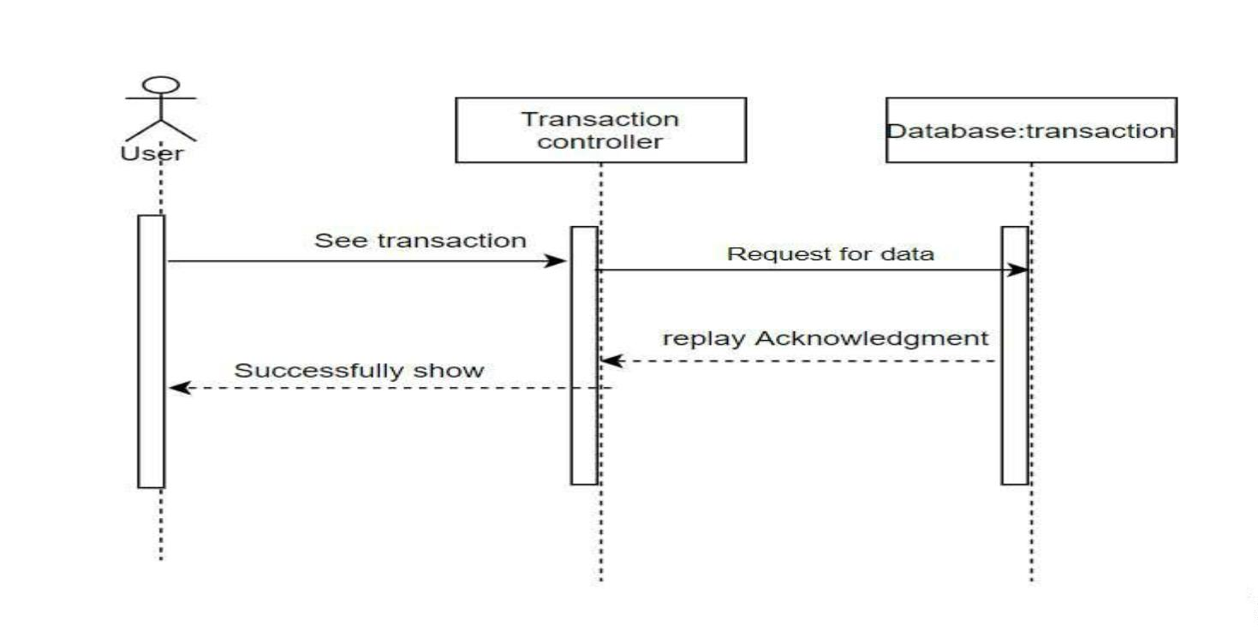
Transaction

Slide 25
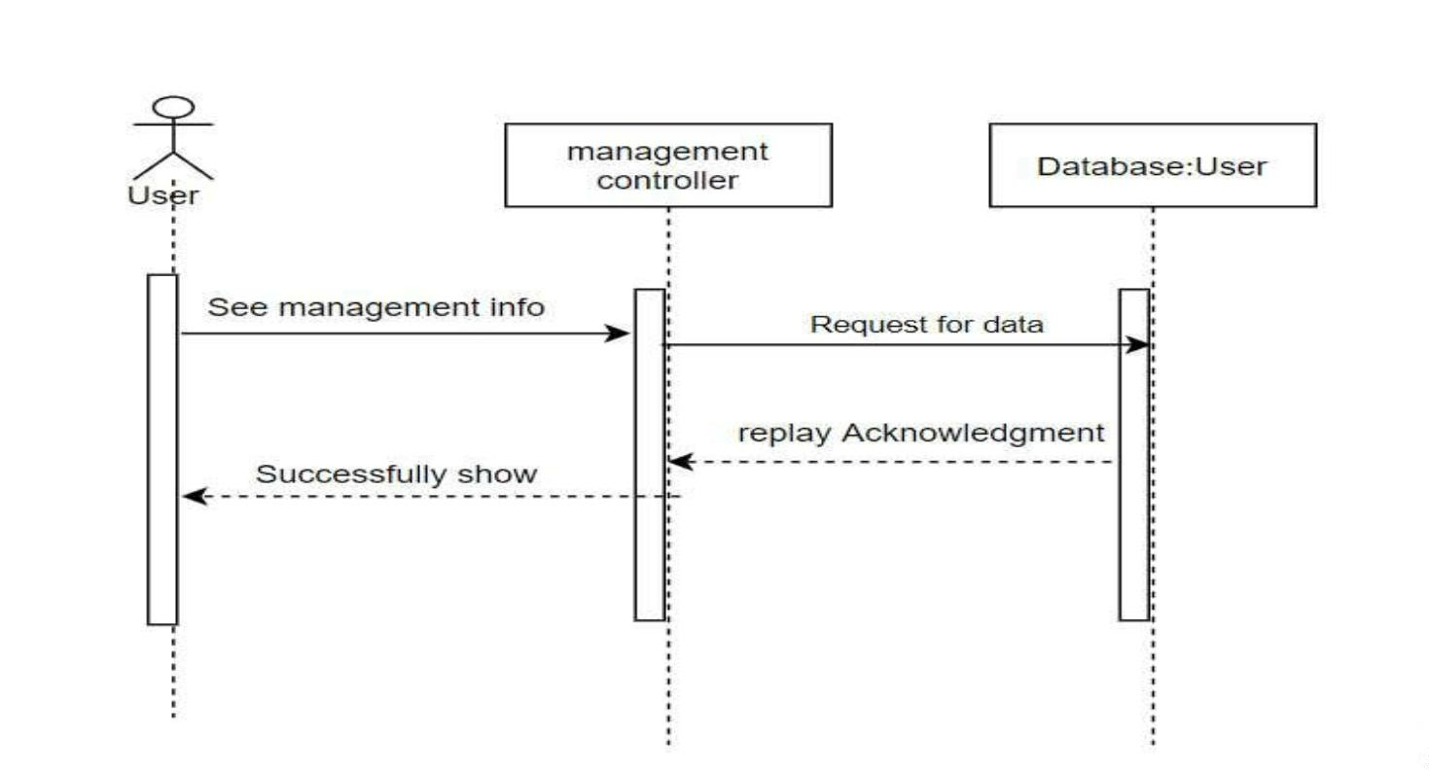
Managements

Slide 26
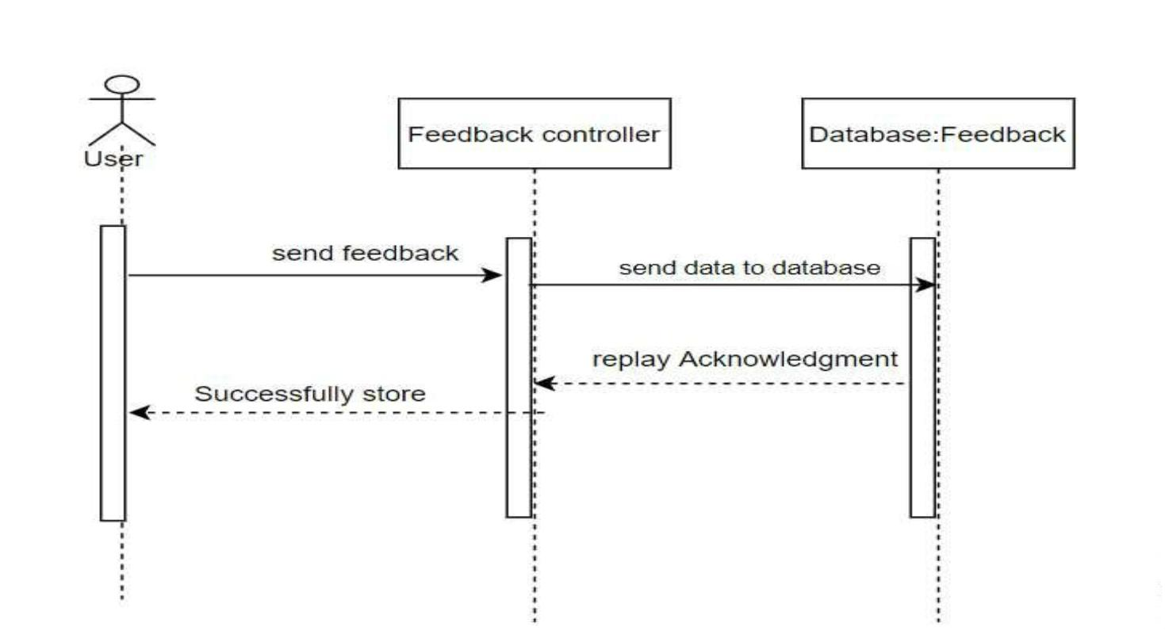
Give Feedback

Slide 27
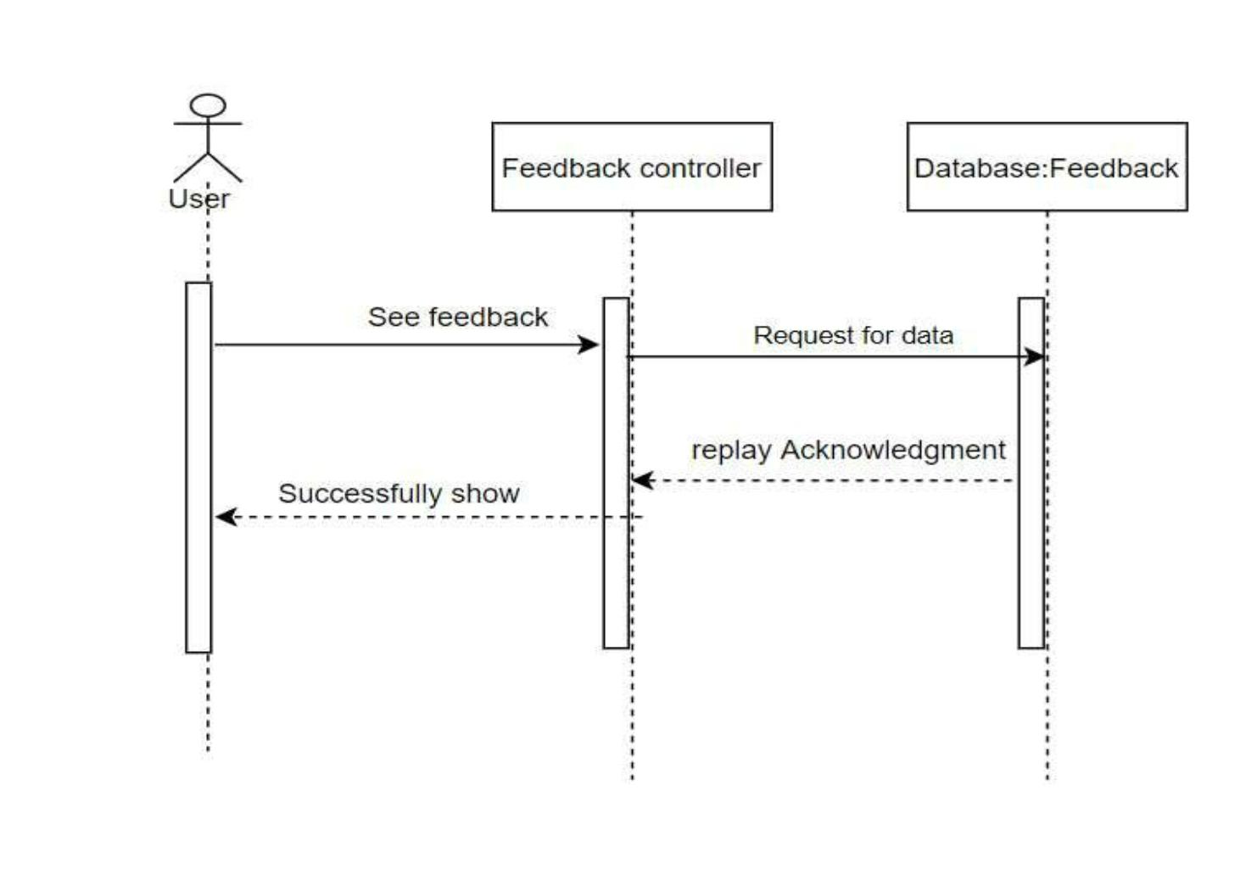
See feedback

Slide 28
Technology Used
Framework – Dot net core mvc
Database – Microsoft SQL server
Server – Local host
Editor – Visual Studio
Front End – HTML, CSS, JS, Bootsrap
Back End – C#
OS – Windows 10

Slide 29
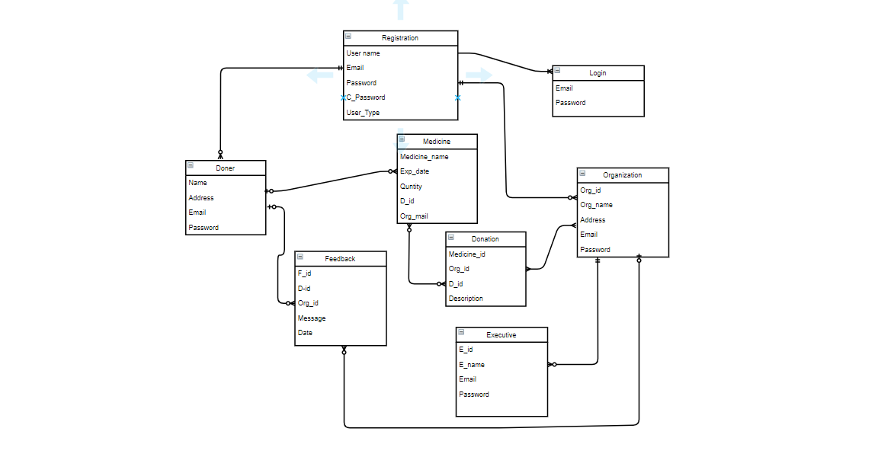
Entity Relationship diagram

Slide 30
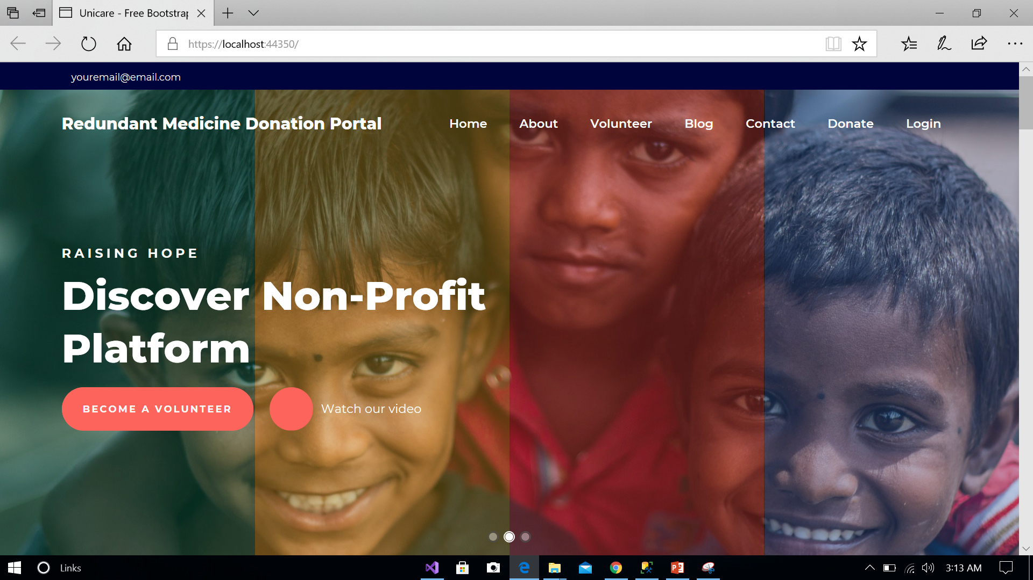
User Manual Home page

Slide 31
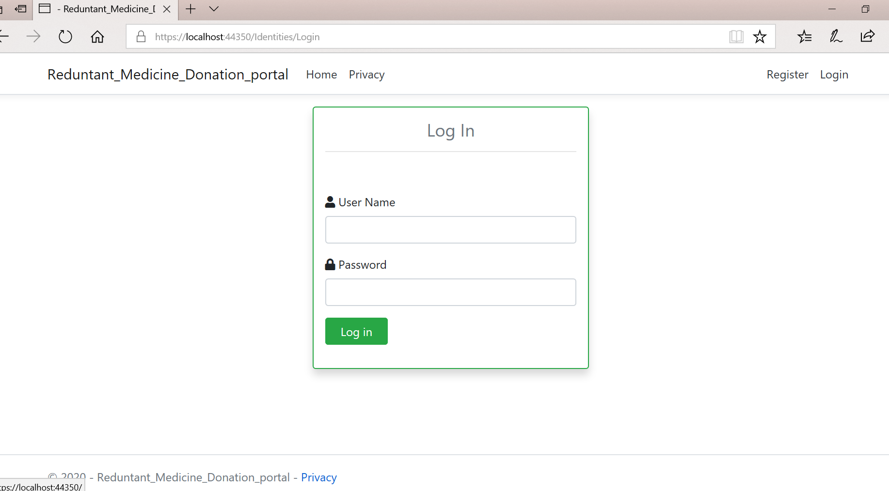
Log in Manual

Slide 32
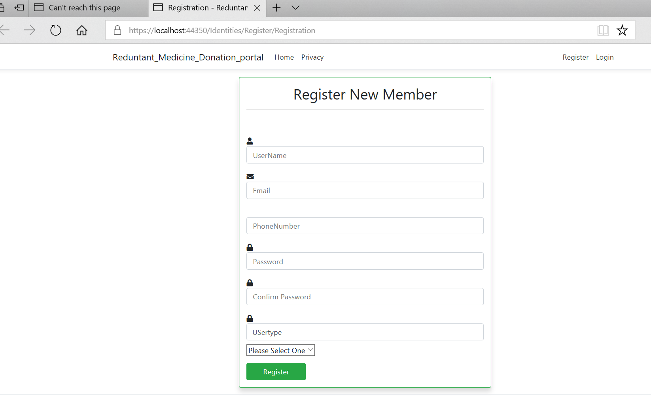
Registration

Slide 33
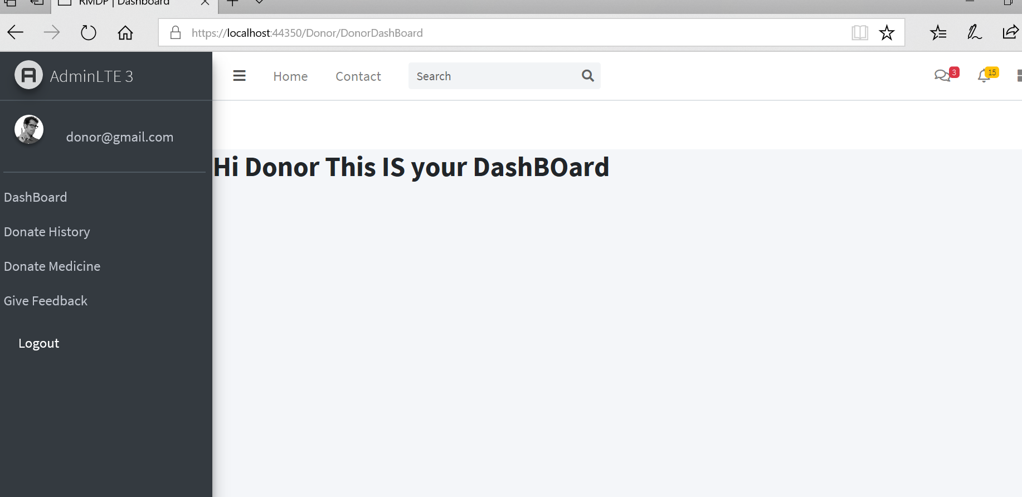
Donor Dashboard

Slide 34
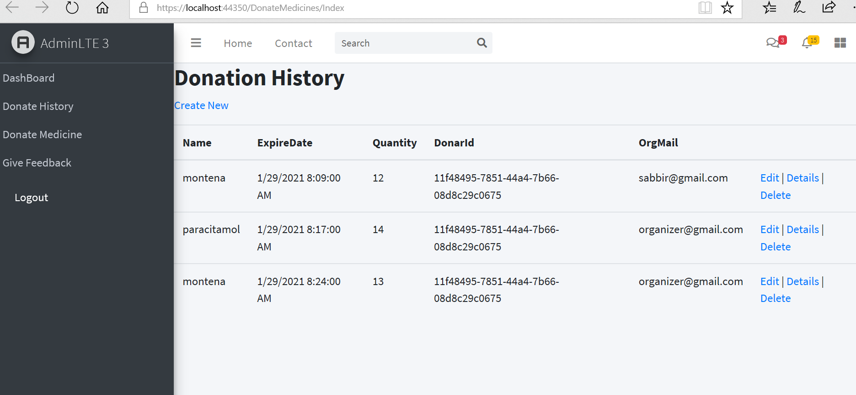
Donation History

Slide 35
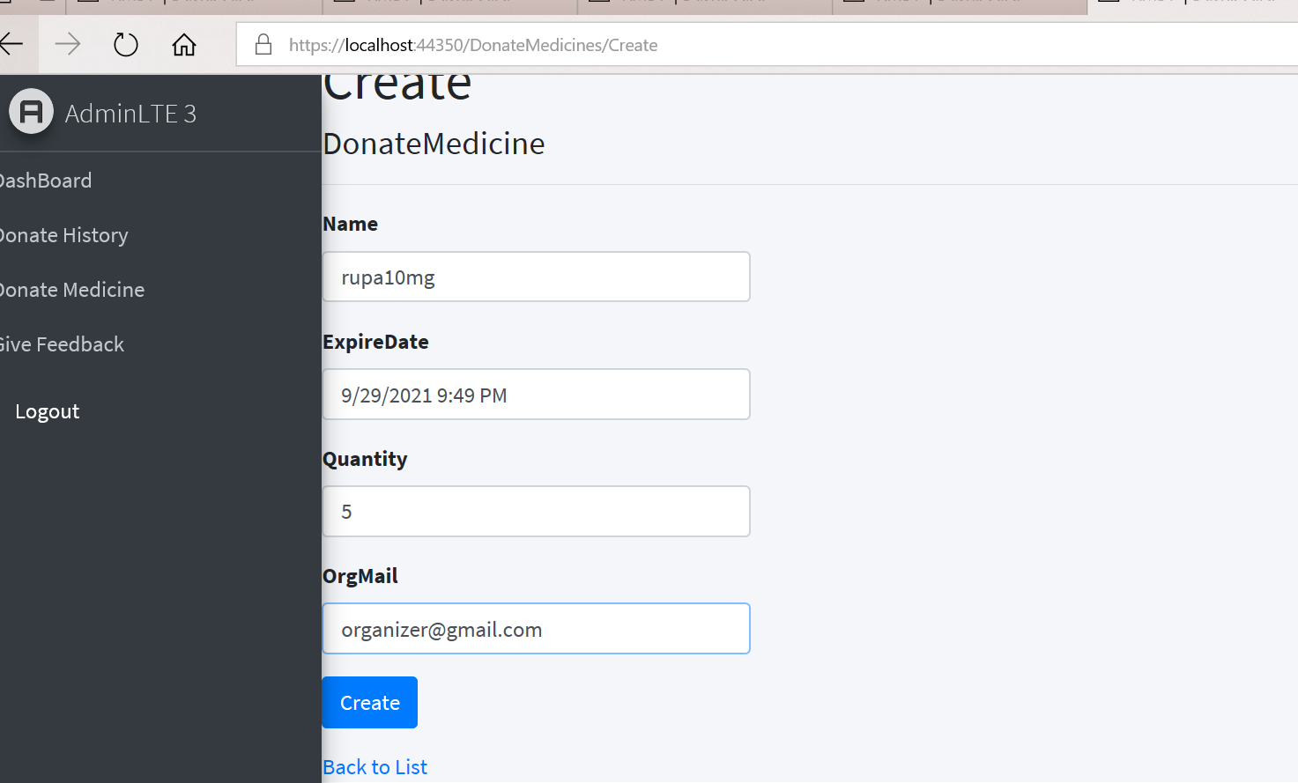
Donate medicine

Slide 36
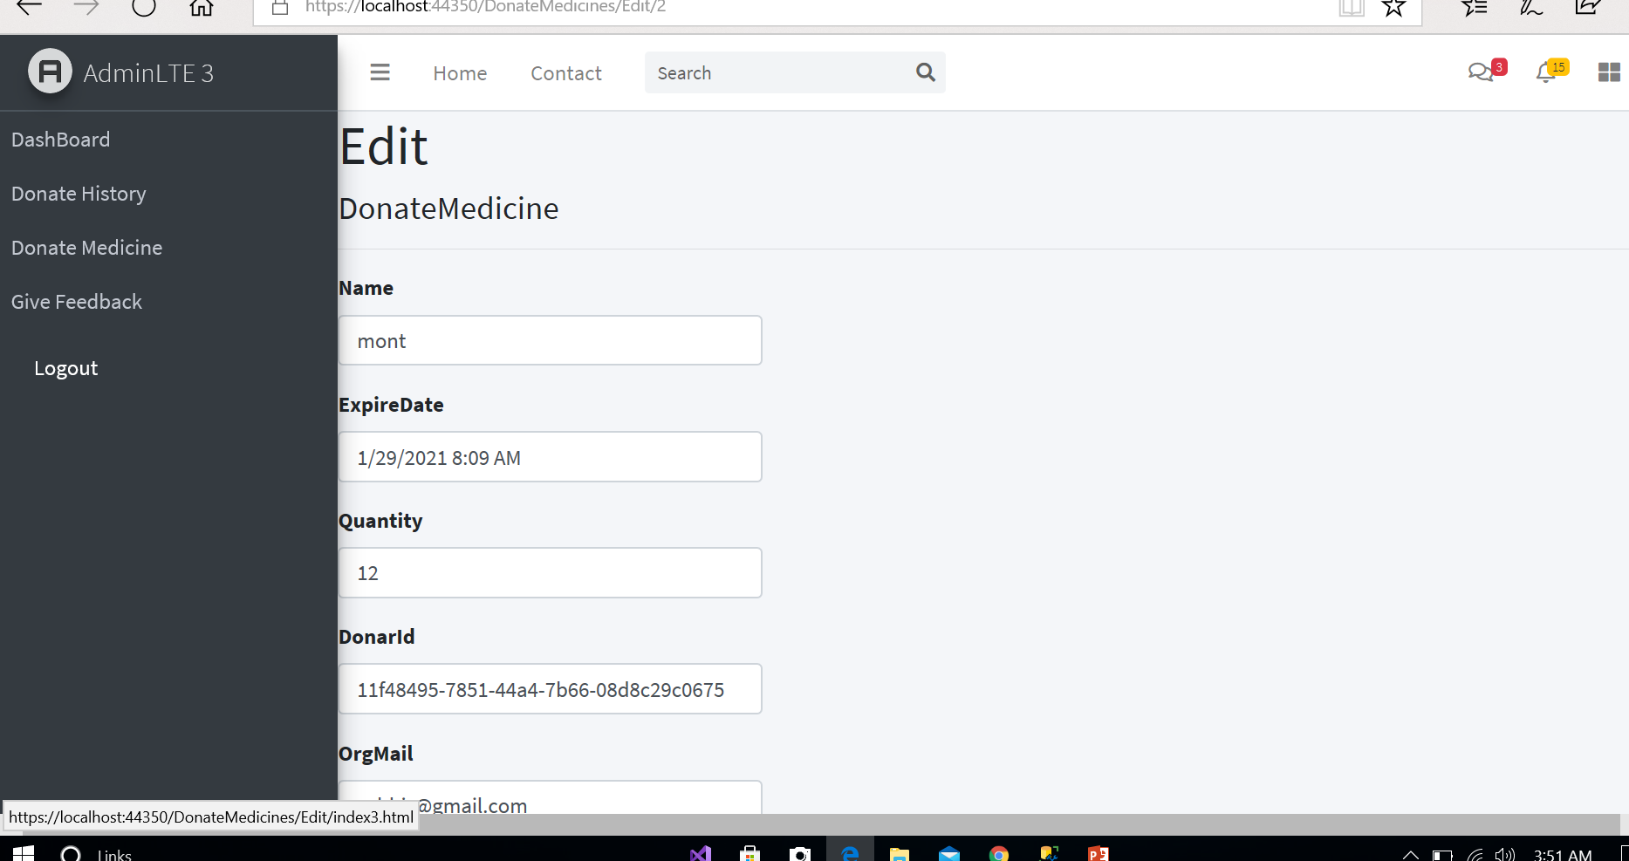
Edit donation data

Slide 37
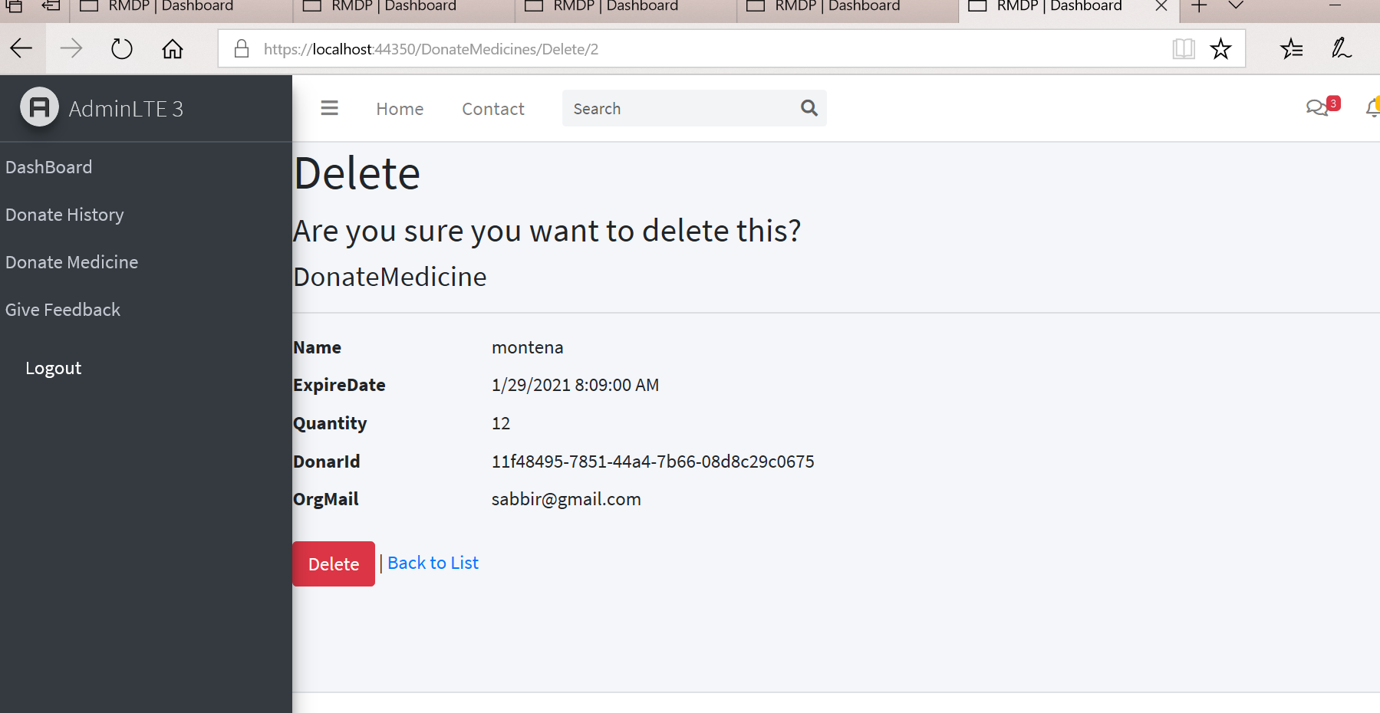
Delete of one donation history

Slide 38
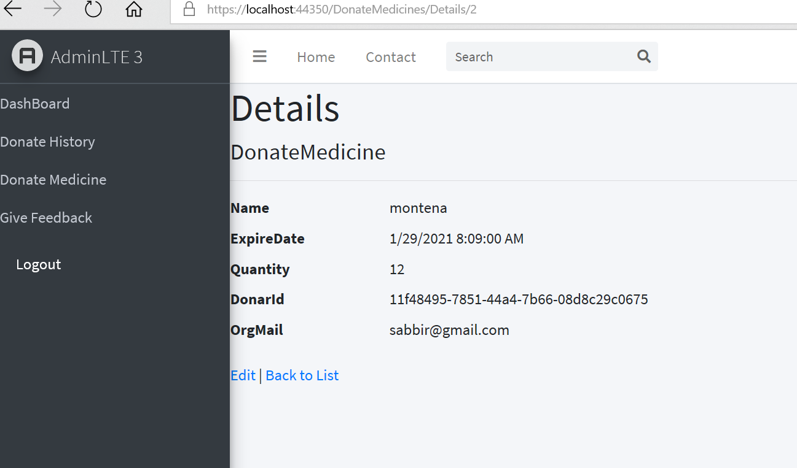
See detail of one dotaiion

Slide 39
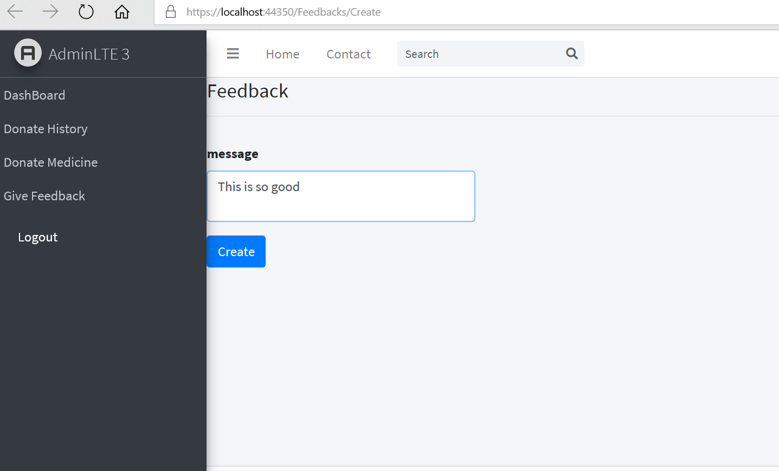
Donor Feedback

Slide 40
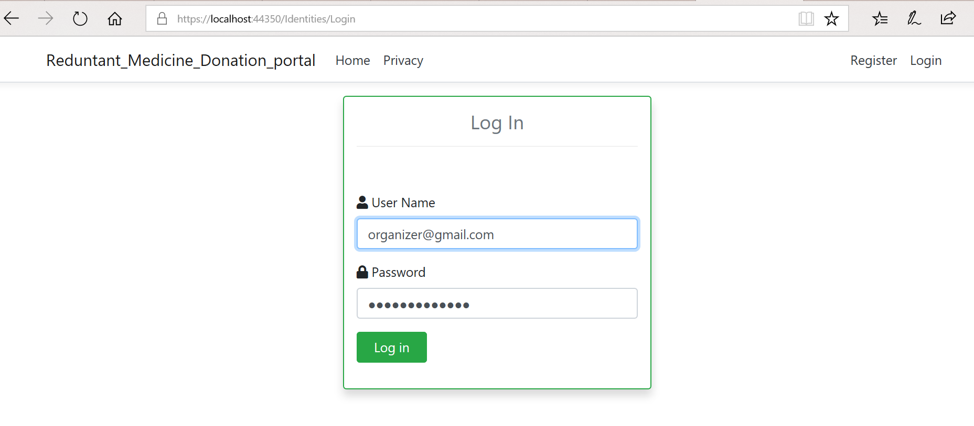
Organization Login

Slide 41
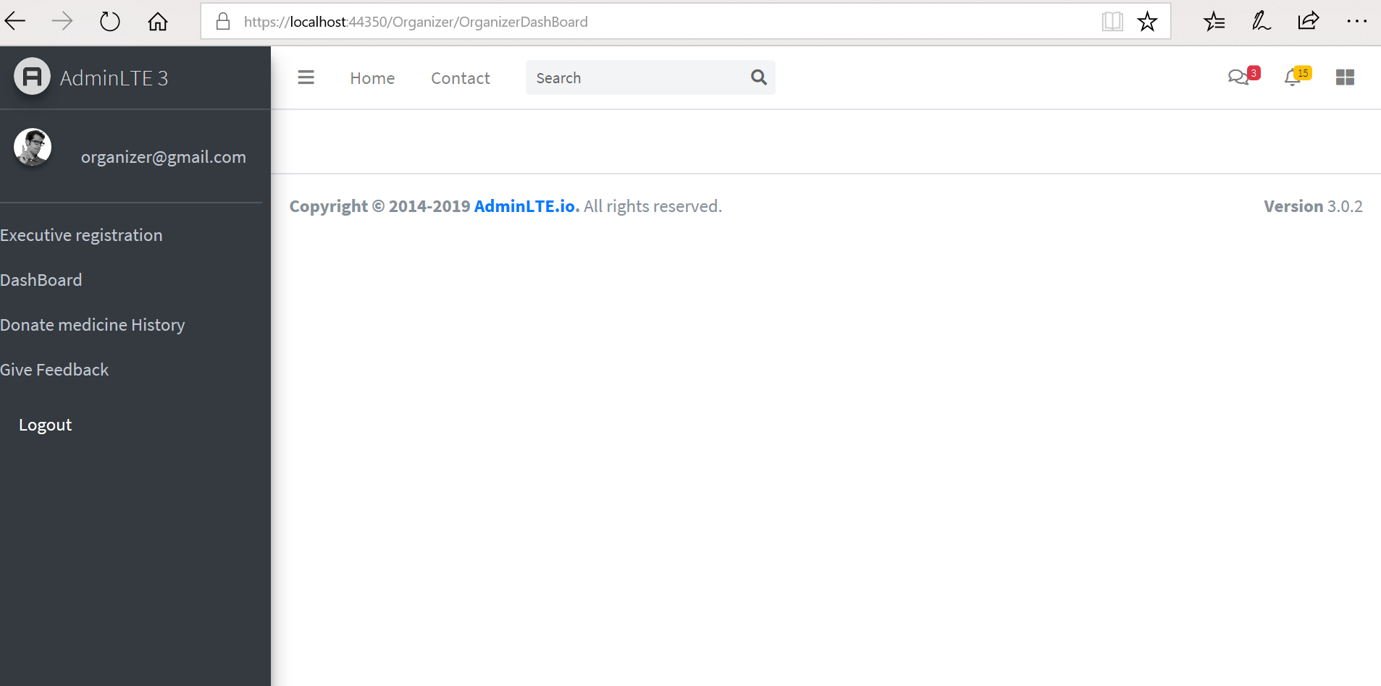
Organization dashboard

Slide 42
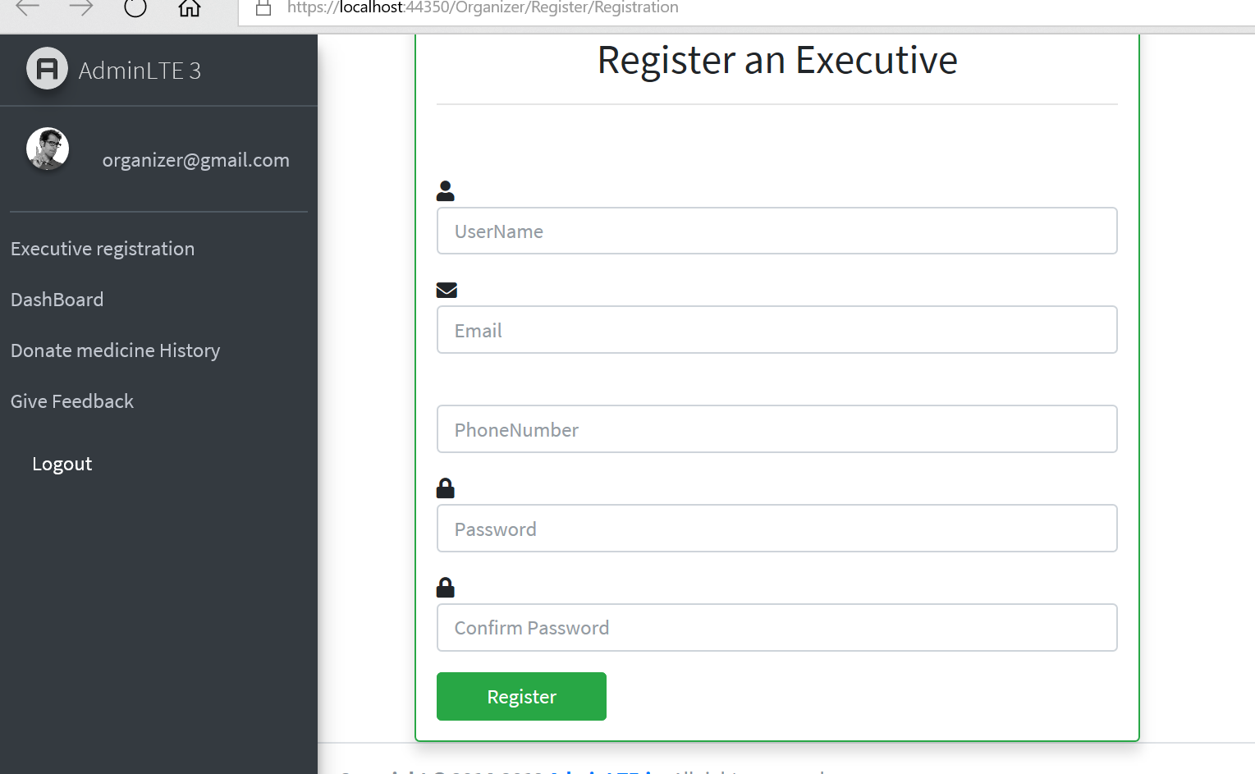
Regitratred of an executive

Slide 43
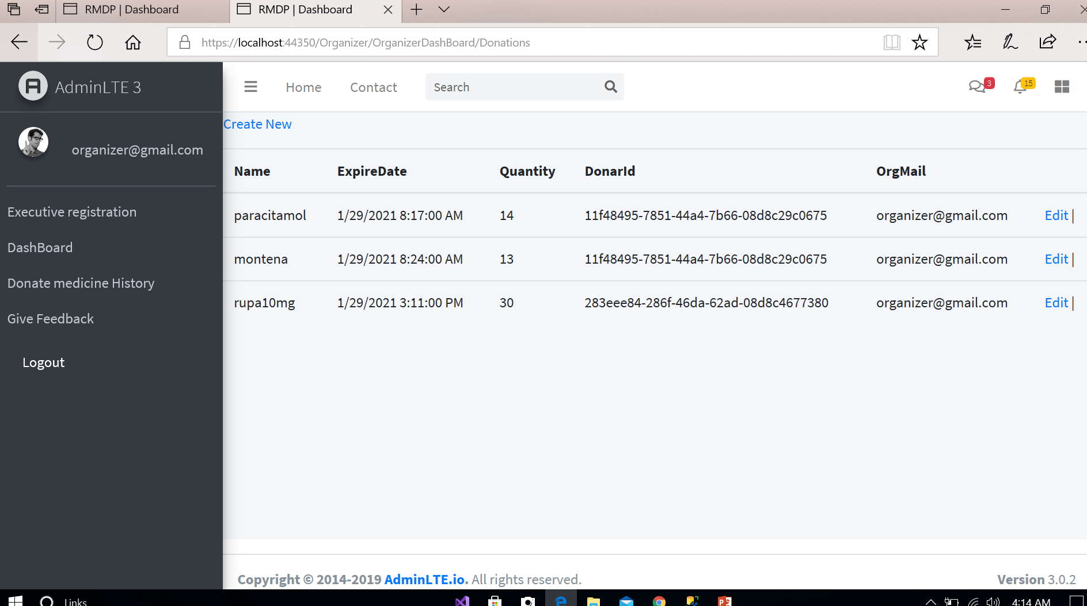
Donating medicine to Organizer

Slide 44
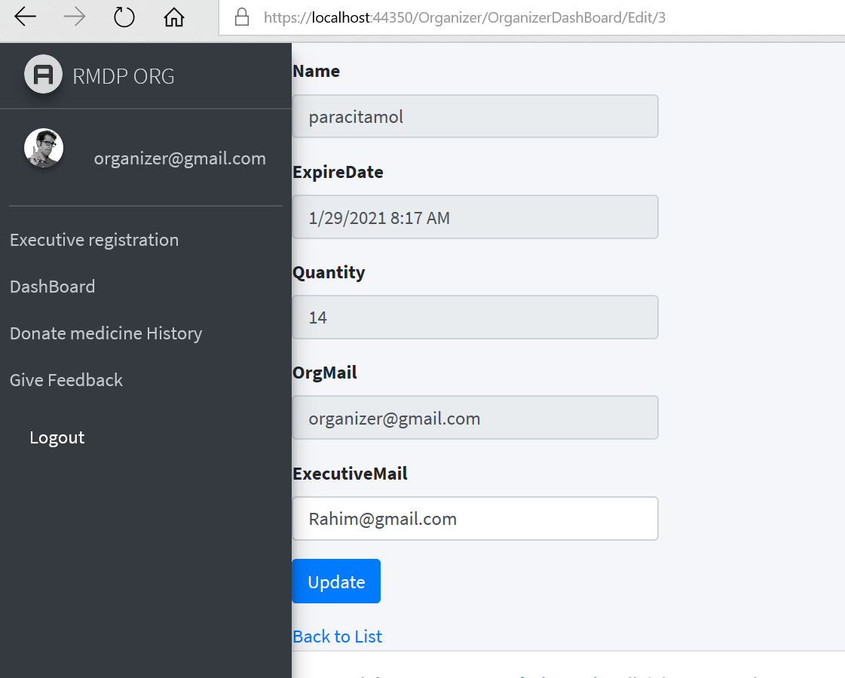
Update and Assign executive

Slide 45
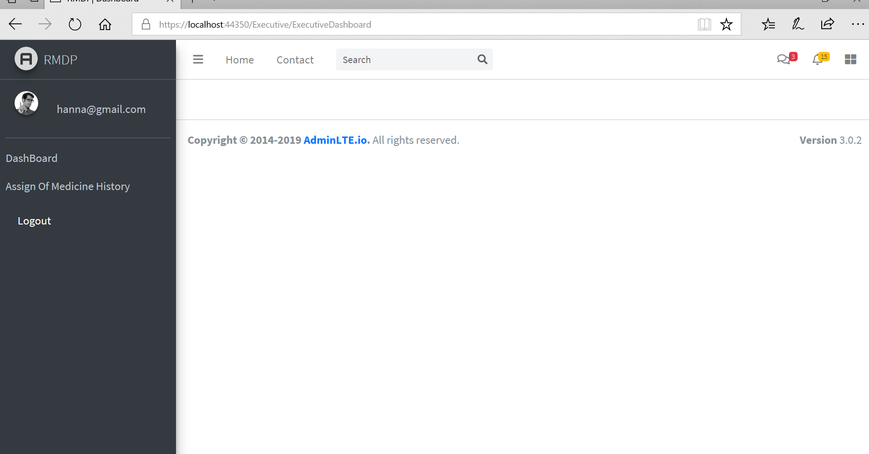
Executive Dashboard

Slide 46
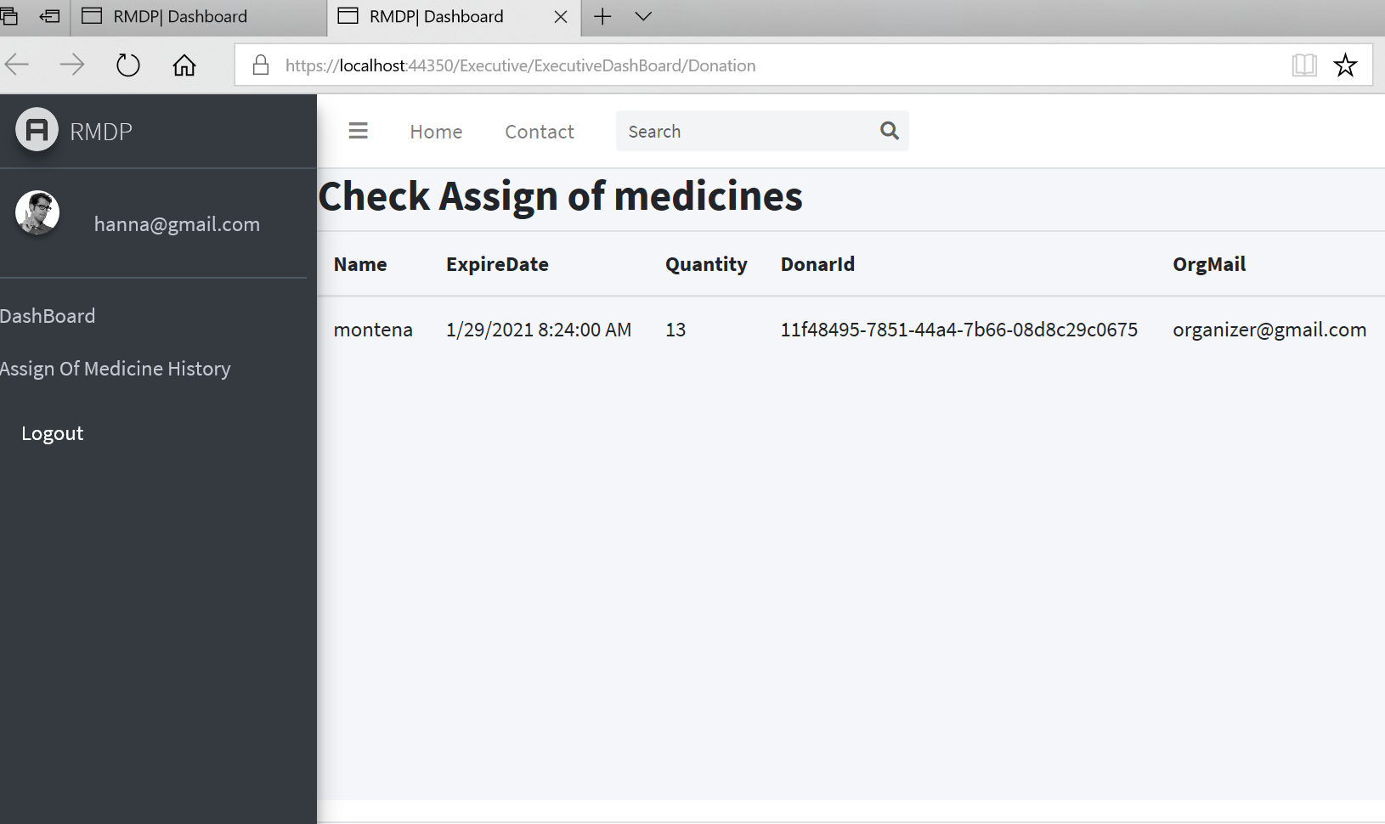
Check Assign

Slide 47
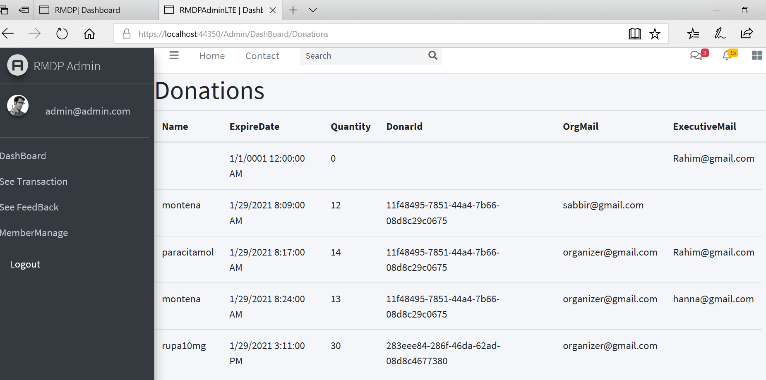
See Transaction

Slide 48
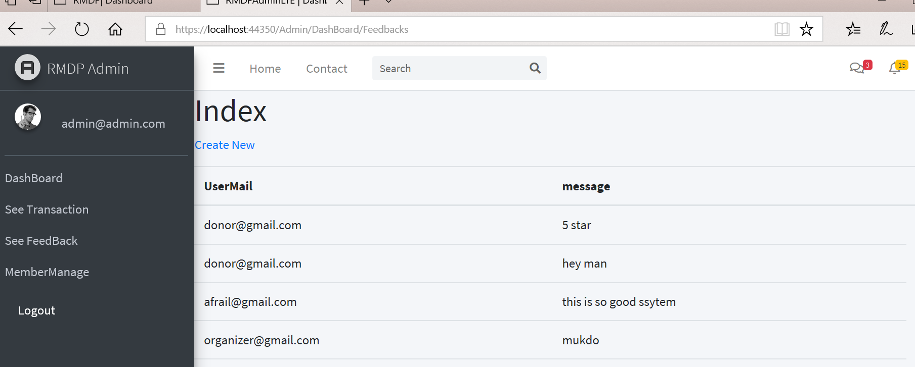
See Feedback

Slide 49
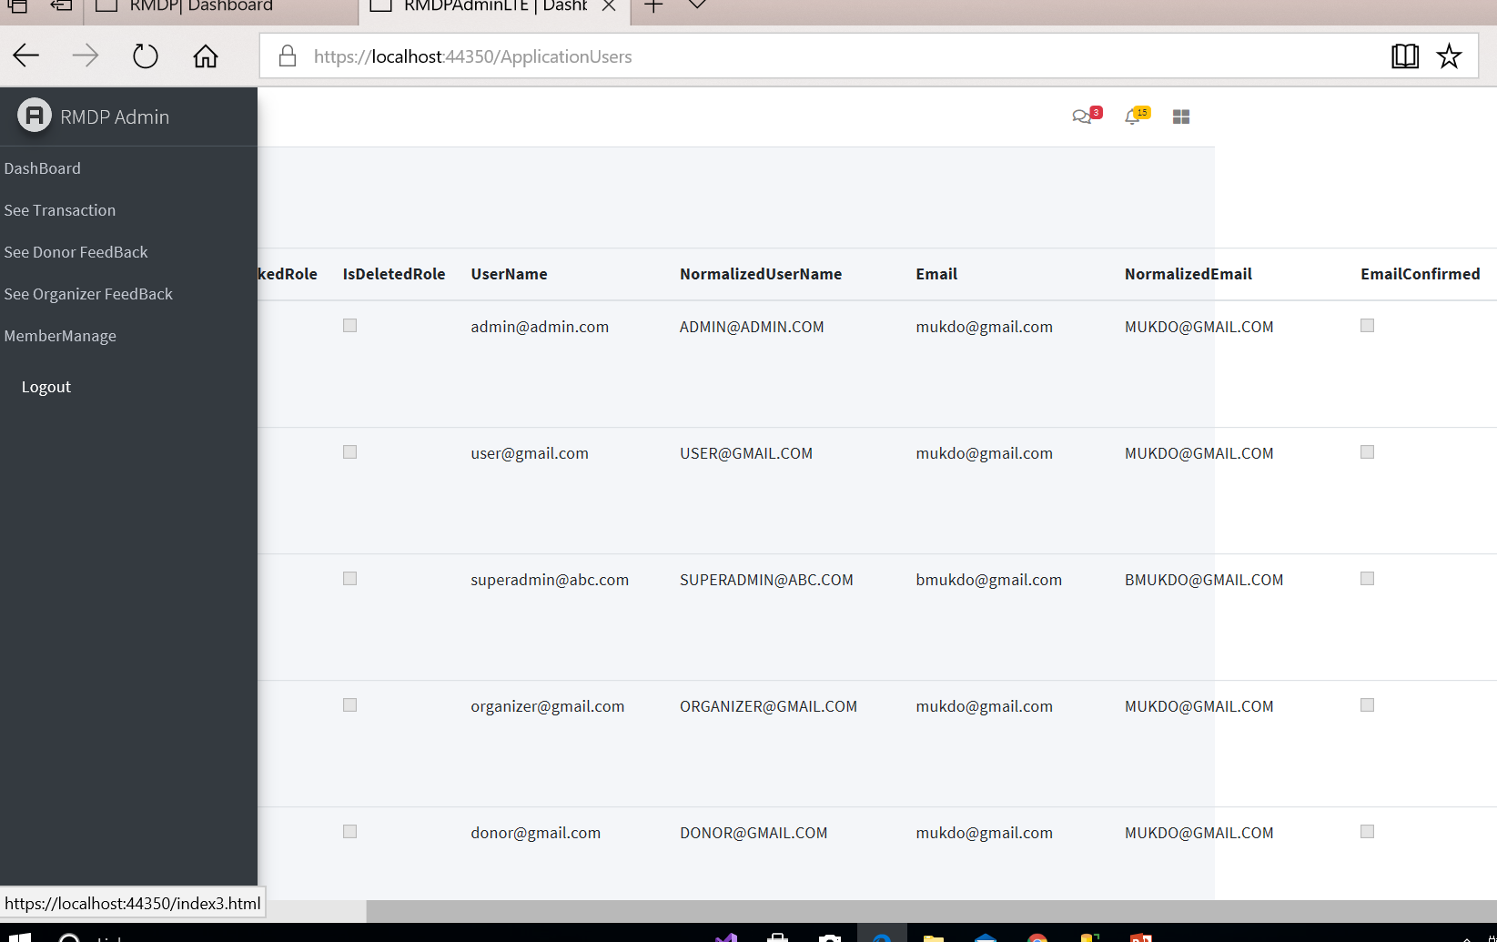
Member Manage

Slide 50
Conclusion
This drug donation system helps the user to donate unused medicines to Health organization / NGO. And The unused medicine can be donated for further utilization by a needy person who have not ability to buy medicine .So poor people really help for this system. And also health organization get a big support from donator to service poor or needy people. And we support and update our system so that all user can use more effectively this system

Slide 51
Thank you

